Slide 1


Quality 4.0: Artificial intelligence for manufacturing innovation
Black belt training
Carlos Escobar, PhD
Quality 4.0 Institute

Slide 2


Slide 3

ASQ QUALITY INNOVATIONS SUMMIT
September 19 - 21, 2023 | Boston, MA
https://asq.org/conferences/qis/registration
The Quality Show
October 24-26, 2023 | Chicago Illinois
https://www.qualitymag.com/quality-show
BOSCON 2023
November 6-7, 2023 | Boston, MA

Slide 4
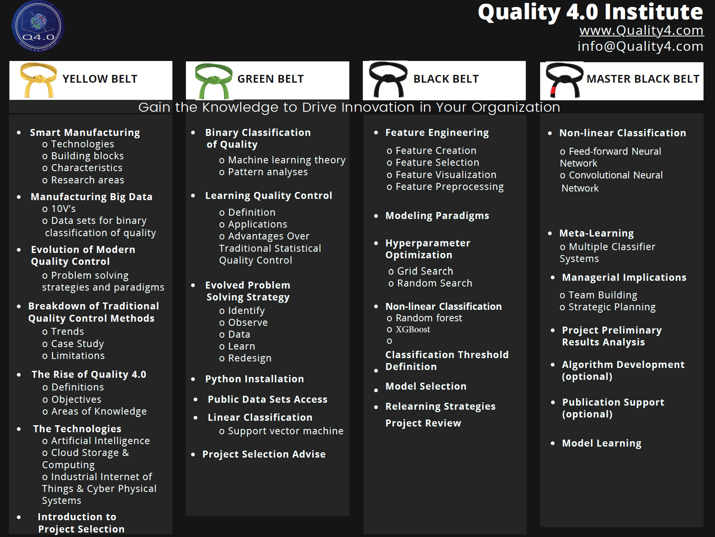
About the program

Slide 5

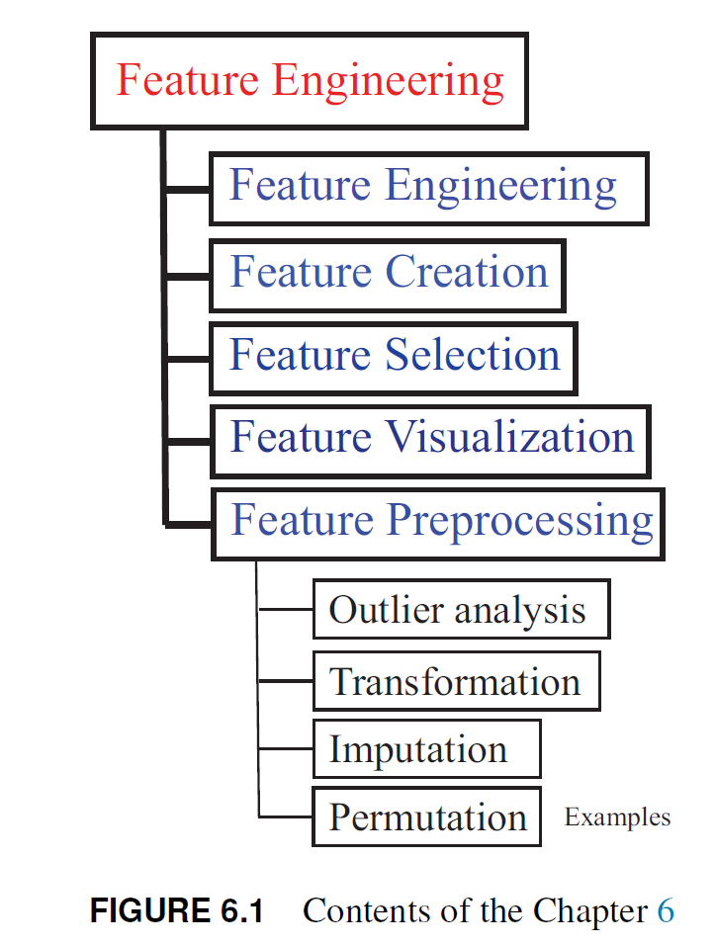

Chapter 6: Feature Engineering
Notes:
In the following slides

Slide 6
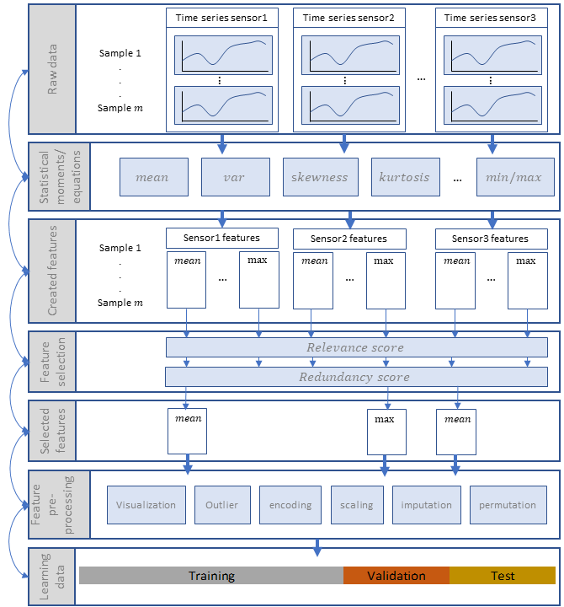
Feature engineering
Fundamental topic in supervised learning using structured data
Process of applying statistical and machine learning ML methods to:
  Create features from the raw data
  Select a subset of the most important ones
  Pre-process them to finally create the learning data set; which is then used to train the machine learning algorithms MLA
Iterative approach that may require feedback loops focused at improving the solution process.

Slide 7
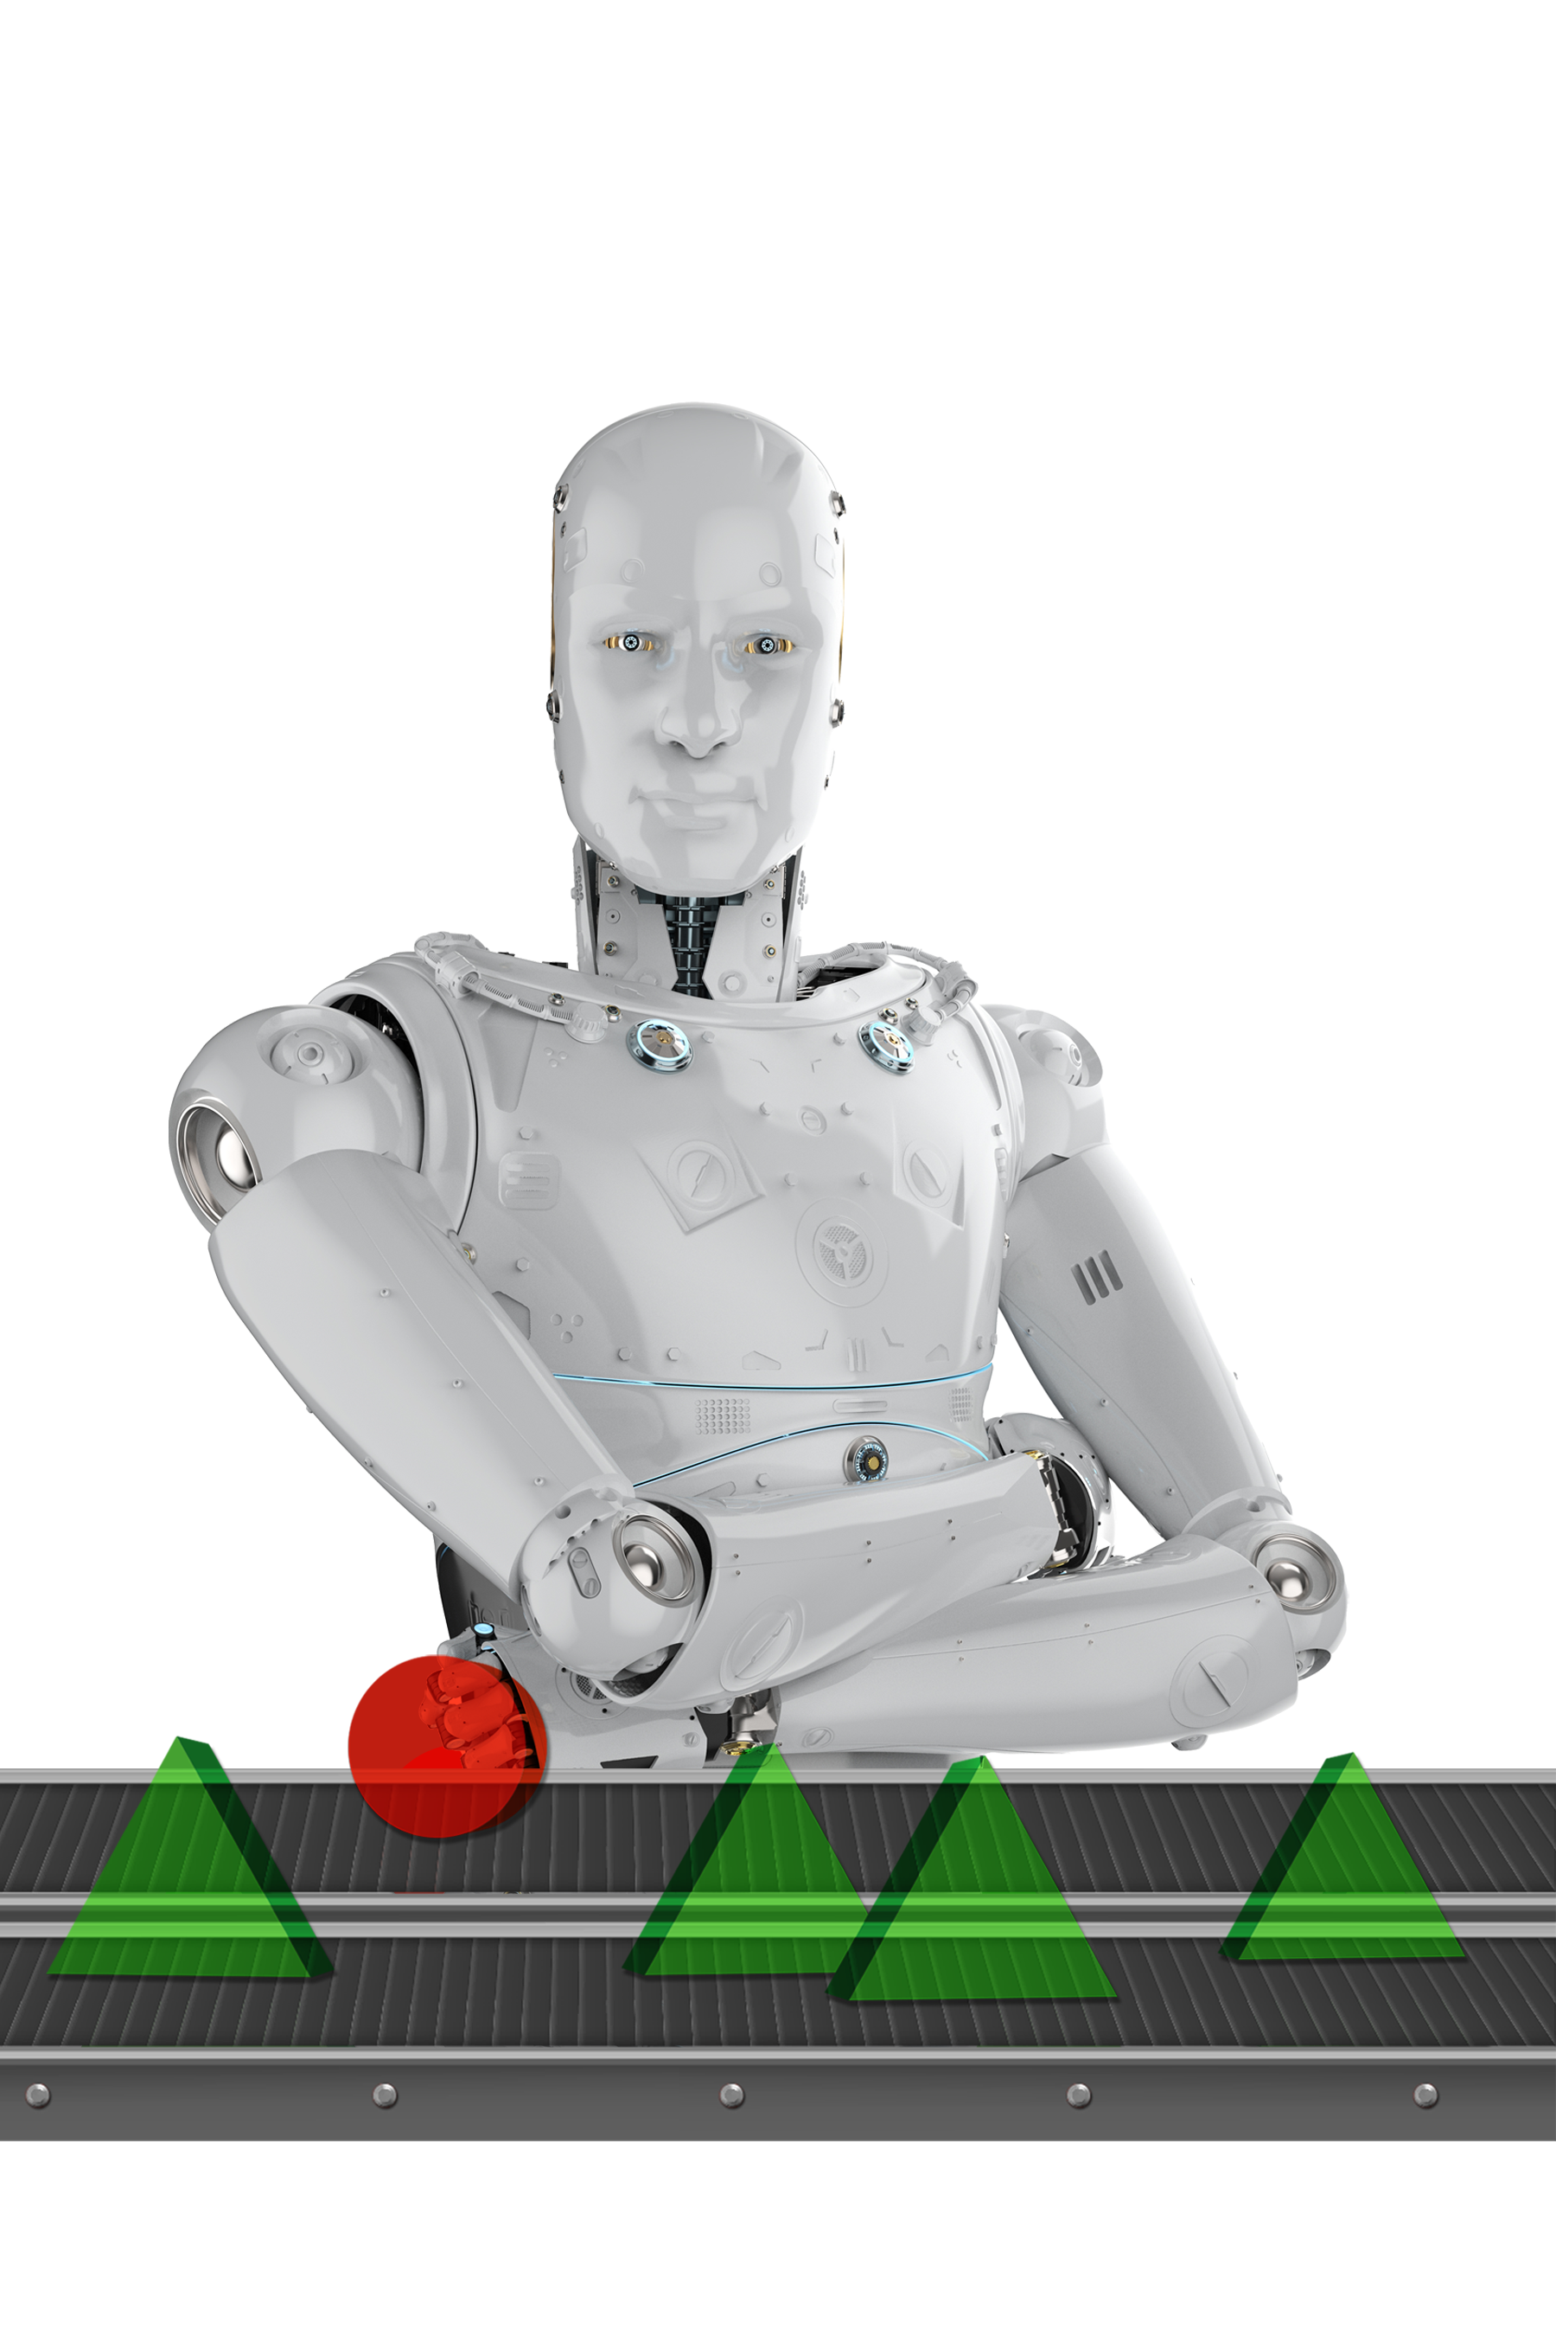
Feature creation
Notes:
In the following slides

Slide 8
Feature creation
Domain knowledge
Equations
Process measurements
Features
Features help to develop a model that performs well on unseen data
Must contain discriminative information and be independent from each other
Highly relies on human intervention to study the process to identify the potential features
Derived from signals or by creatively mixing the existing ones to generate new ones with more discriminative information than the originals
Statistical moments and equations, such as subtractions, additions, ratios, and multiplications

Slide 9
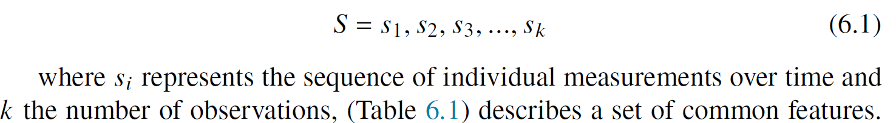
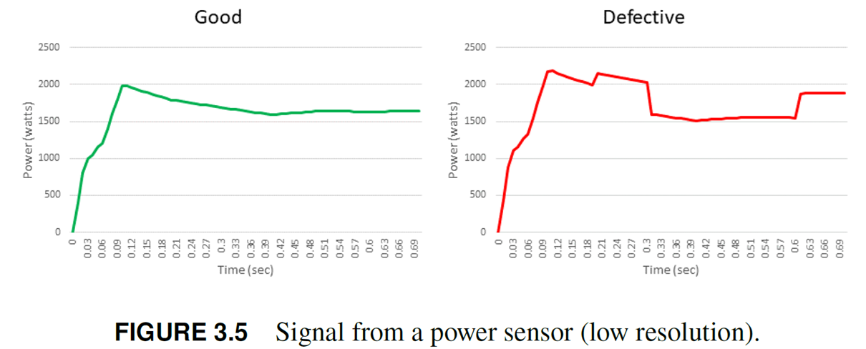
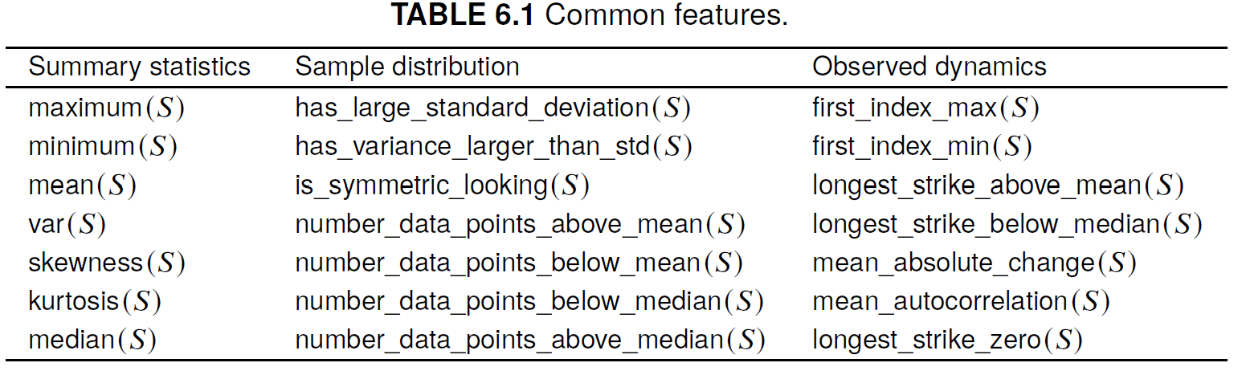
Feature creation
From signals
Important to apply feature section methods to identify the driving features of the system and to eliminate the redundant, trivial, and irrelevant ones

Slide 10
Feature selection
Notes:
In the following slides

Slide 11
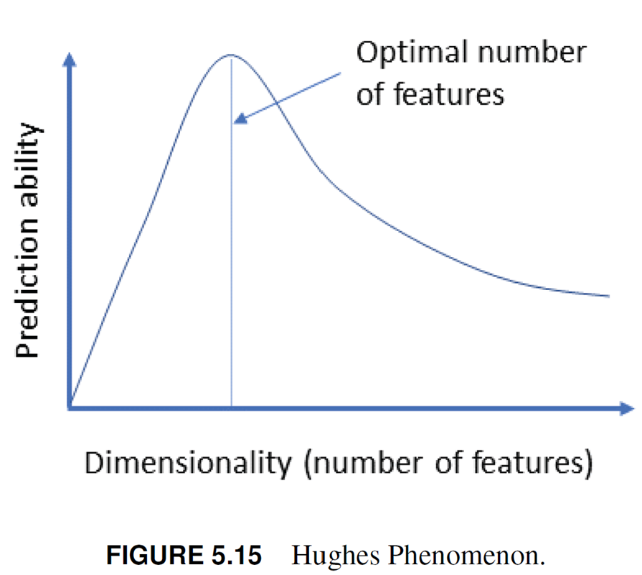
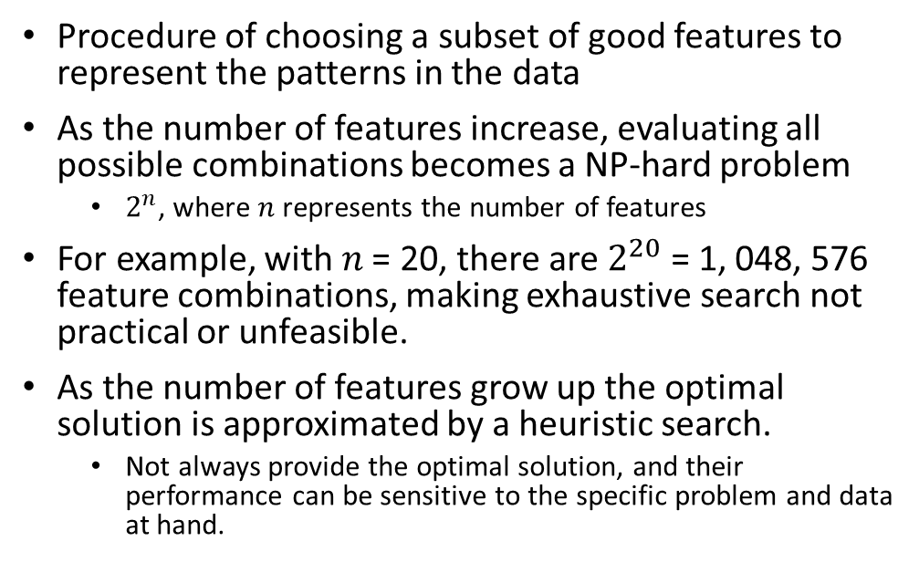
Feature selection (or elimination)
Procedure of choosing a subset of good features to represent the patterns in the data
As the number of features increase, evaluating all possible combinations becomes a NP-hard problem
  $2^{n}$, where 𝑛 represents the number of features
For example, with 𝑛 = 20, there are $2^{20}$ = 1, 048, 576 feature combinations, making exhaustive search not practical or unfeasible.
As the number of features grow up the optimal solution is approximated by a heuristic search.
  Not always provide the optimal solution, and their performance can be sensitive to the specific problem and data at hand.

Slide 12
Feature selection (or elimination)
Quality patterns are typically captured by only a few important features, followed by those of lesser importance and, finally, by a myriad of trivial, redundant, and irrelevant ones
Irrelevant features do not contribute to the prediction task and may even introduce noise into the data. These features can confuse the model and reduce its prediction ability
Redundant features contain the same or similar information as other features in the data set. The correlation coefficient is a common measure of redundancy
  These features do not add any new information to the model and can increase the complexity of the model, making it more difficult to train and interpret.
Trivial features are those that contain little discriminative information, such as a feature with quasi-constant values.

Slide 13
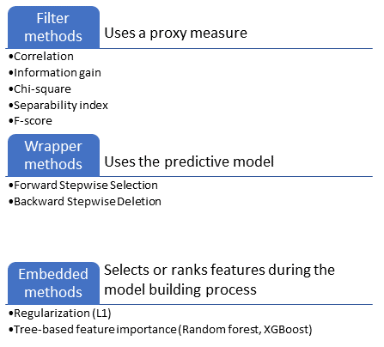
Feature selection (or elimination)
Feature selection methods broadly fall into 3 categories:
Filters
Wrappers
Embedded

Slide 14
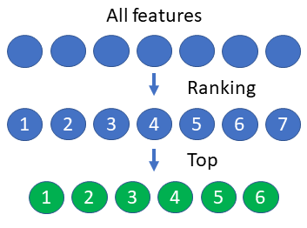
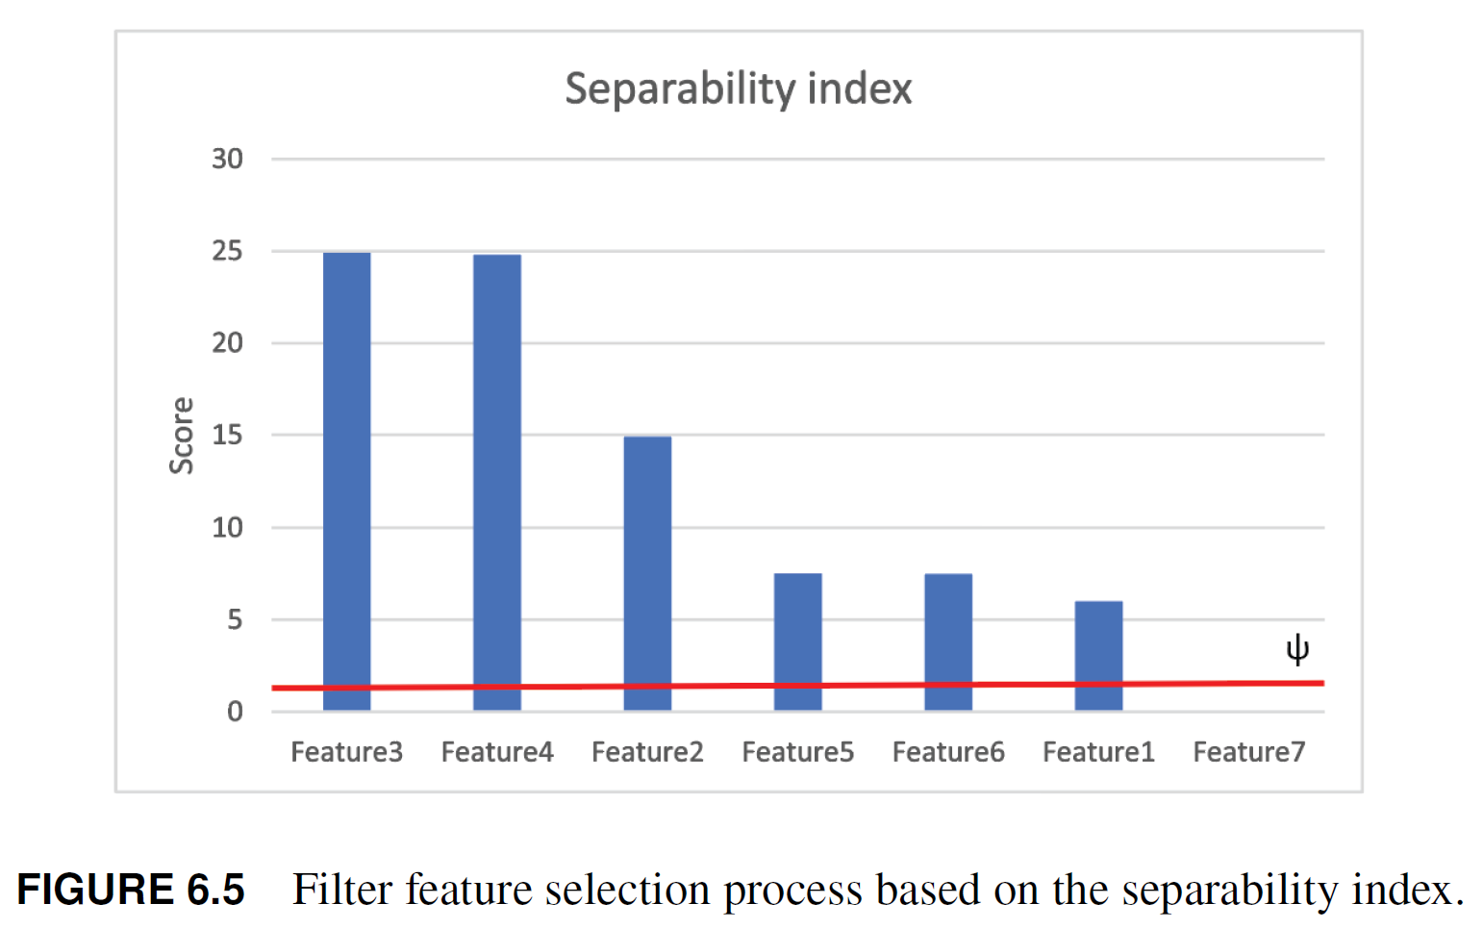
Feature selection (or elimination)
Filter
Applied before the learning process
Independently compute the fitness score of each feature, which is then used to rank them
Scores are compared with a relevance threshold to select a subset of relevant features
Fast and a good approach to eliminate features, specially when the feature space is large
Select features independently of the MLA, therefore, the accuracy of the model may be not high, as compared to the wrappers methods, because the selected features are not customized for the specific MLA

Slide 15
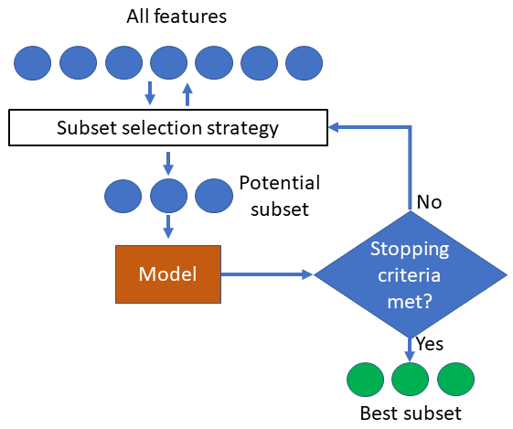
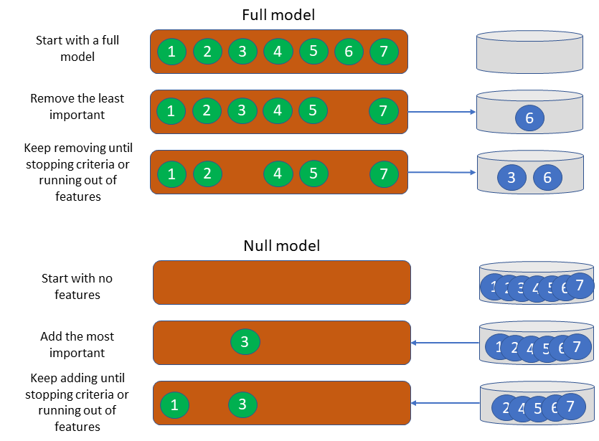
Feature selection (or elimination)
Wrapper
Use the learning algorithm as a black-box to evaluate the relative performance of a feature subset
Highly rely on greedy selection algorithms
Tend to be computationally intensive
Due to the bias induced by the algorithm, they perform better than filters

Slide 16
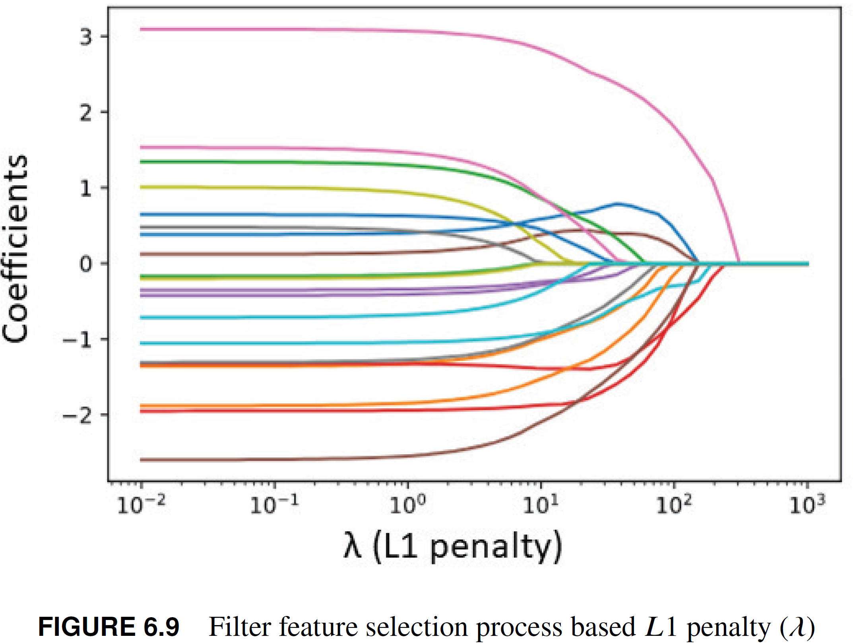
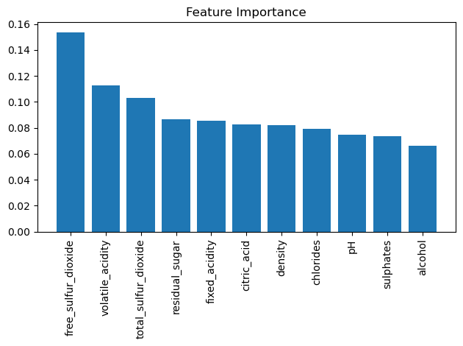
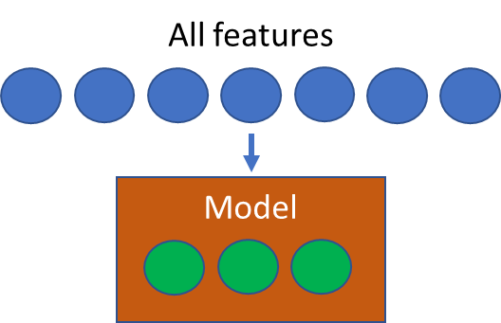
Feature selection (or elimination)
Embedded
Integrated as part of the learning process
Involve modifying the model’s learning algorithm to include a feature selection step
Model automatically selects the most relevant features during the training process

Slide 17
Feature selection (or elimination)
Benefits
Enhances model performance, interpretability, and efficiency.
Mitigates the curse of dimensionality by eliminating irrelevant, trivial, and redundant features
Reduces computation time and memory usage
Improves model generalization by focusing on the most informative features, thereby reducing overfitting and enhancing the model's ability to handle unseen data.
Aids in interpretability, allowing researchers and stakeholders to gain insights into the underlying patterns and relationships within the data
Simplifies model implementation and maintenance, as fewer features mean less complexity and easier deployment
Empowers machine learning algorithms to deliver more accurate, efficient, and interpretable results, making it an indispensable step in the data preprocessing pipeline

Slide 18
Feature selection (or elimination)
Remarks
Features should be initially evaluated based by an expert
Best approach for feature selection depends on the specific data-set and model being used, so it is important to try different methods and evaluate their performance

Slide 19
Feature visualization
Notes:
In the following slides

Slide 20
Feature visualization
Involves visualizing the relationship between the input features and the target variable (i.e., the binary class label)
Helps to identify the right pre-processing techniques such as imputation, transformations, manipulations needed to generate the learning data set.
Solving the pattern recognition problem, highly rely on the right application of these techniques.

Slide 21

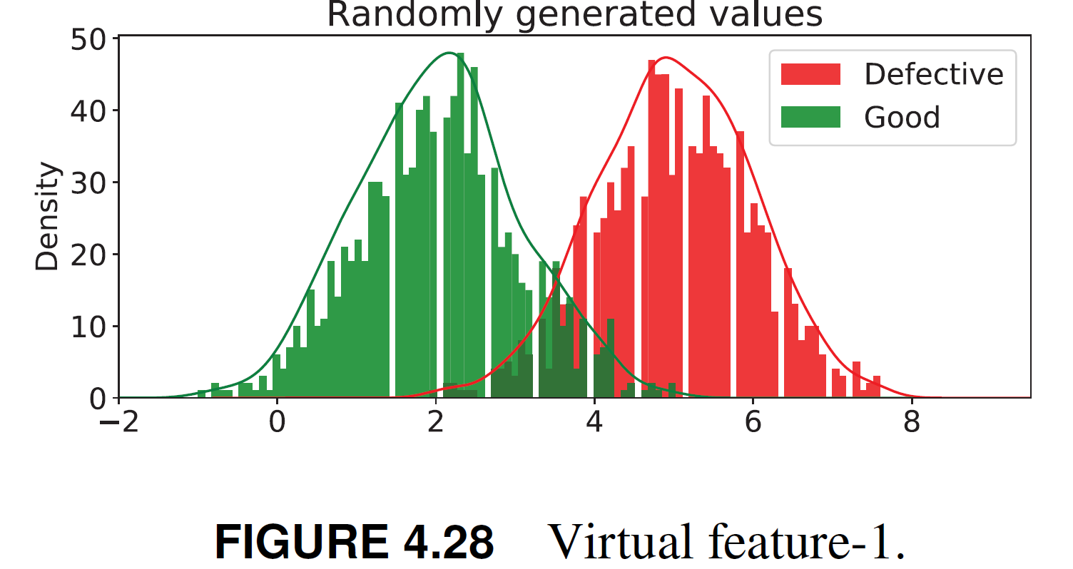
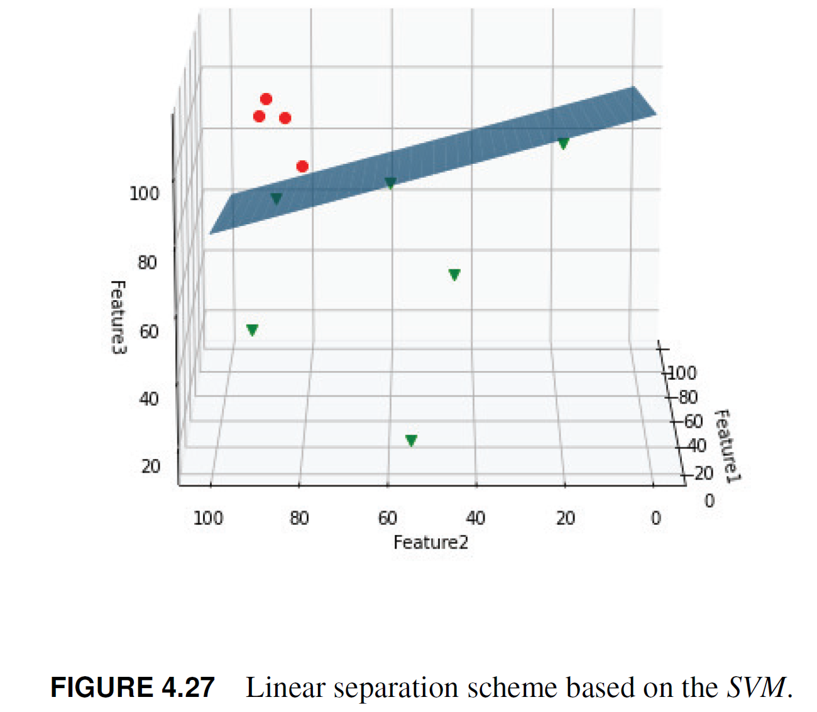
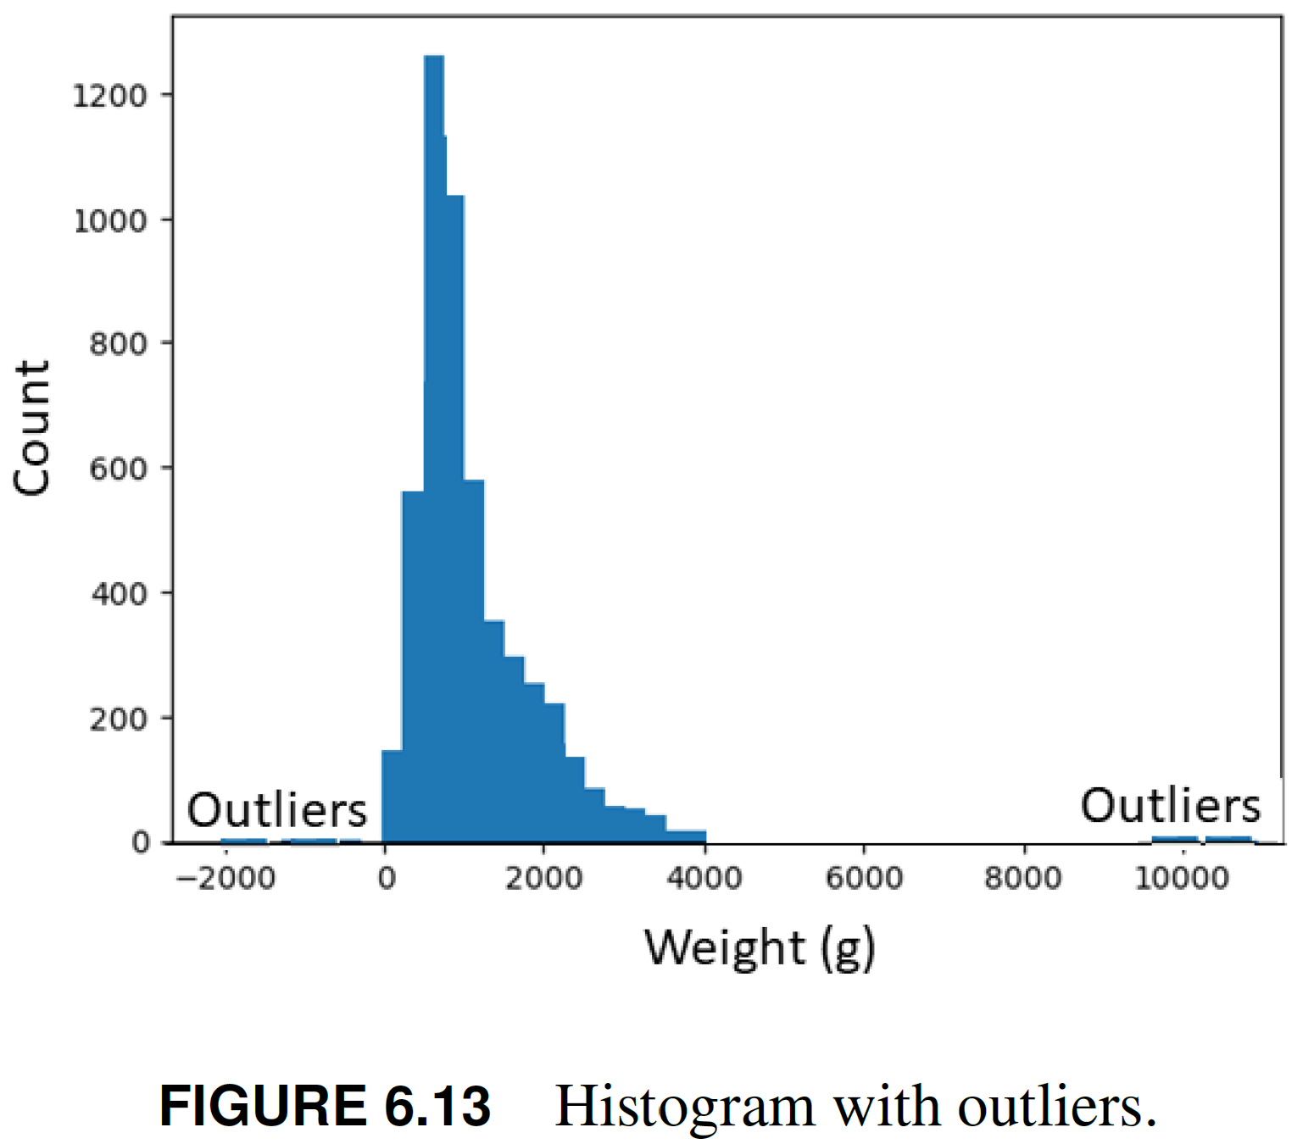
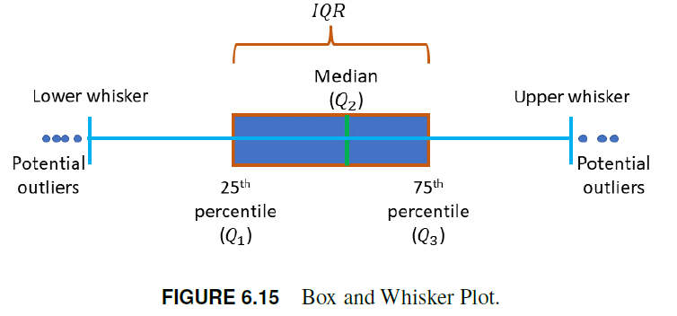
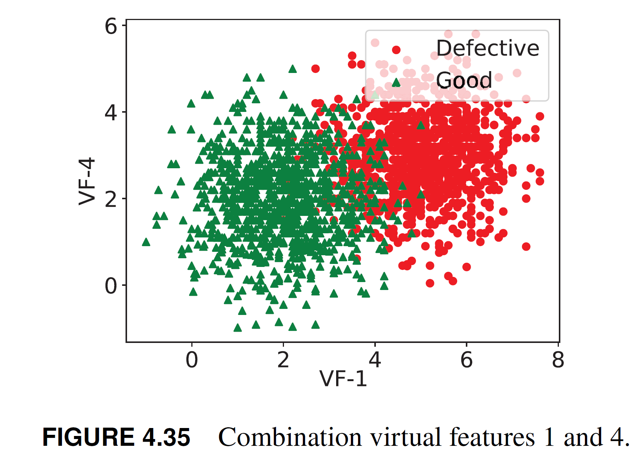
Feature visualization
Visualize distributions
Visualize separation
Visualize the decision boundary
Feature importance

Slide 22
Feature preprocessing
Notes:
In the following slides

Slide 23
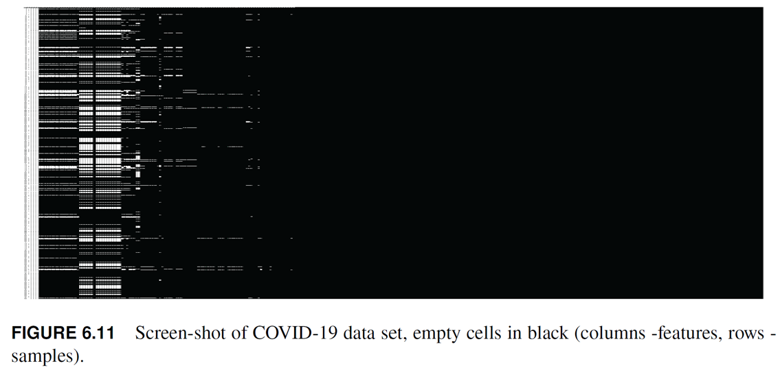
Feature preprocessing
Feature imputation
Many real-world data sets contain missing values for various reasons:
  Corrupt data, failure to load the information, incomplete recording of data entries
Manufacturing, unexpected faulty operating conditions of sensors and cameras

Slide 24
Feature preprocessing
Handling the missing values, which are often encoded as Not a Number (NaN) or blanks, is one of the first technical challenges
Missing data results in loss of learning power
Selecting the right approach on how to handle it, is very important to develop robust models
Deleting rows or columns with missing data is a widely used approach
If this naive method is applied, oftentimes the sample size may be significantly reduced, leaving little information for the MLA to learn the patterns
Not advised unless the proportion of eliminated records is very small (< 5%)

Slide 25
Feature preprocessing
Feature imputation is the process of filling in missing or incomplete values in a data set
Most MLA require complete data sets to function properly
Techniques
  Mean imputation
  Median imputation
  Mode imputation
  K-nearest neighbors imputation
If the data set contains many missing values row deletion or imputation is not a good idea, as most of the data would be either deleted or artificial
Feature permutation is a better option

Slide 26

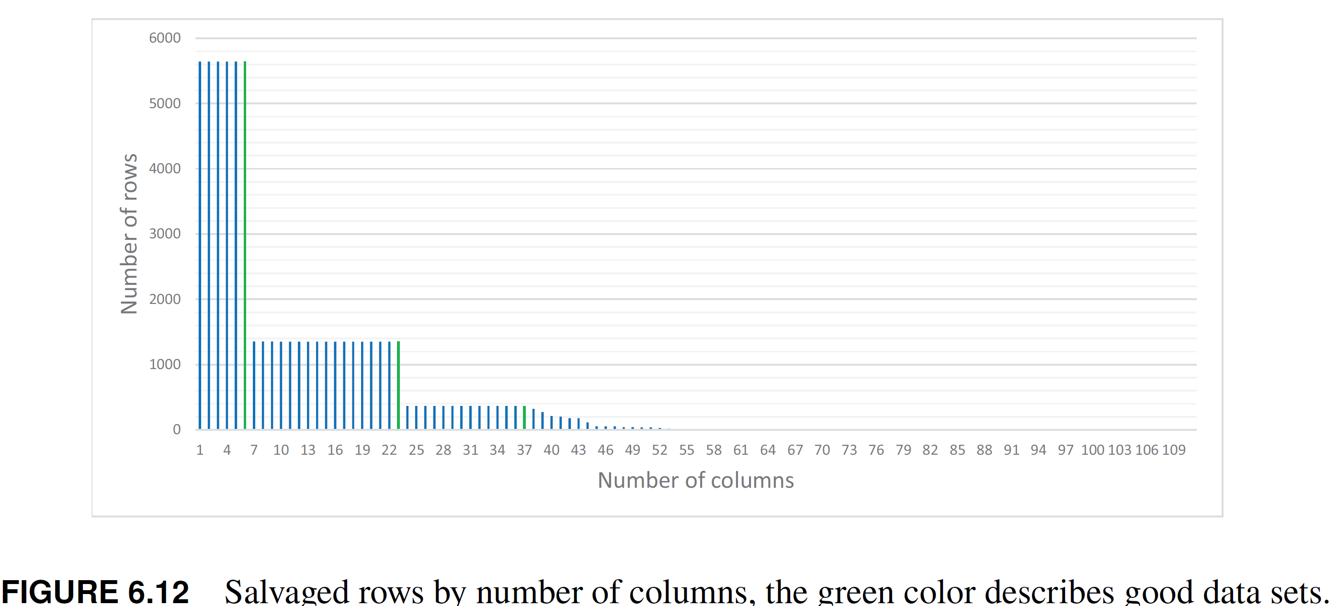
Feature preprocessing
Feature permutation
To avoid the bias induced by imputation methods, first, a feature permutation algorithm should be applied to maximize the number of records used for learning
Determine which features should be used for learning and which ones should eliminated

Slide 27
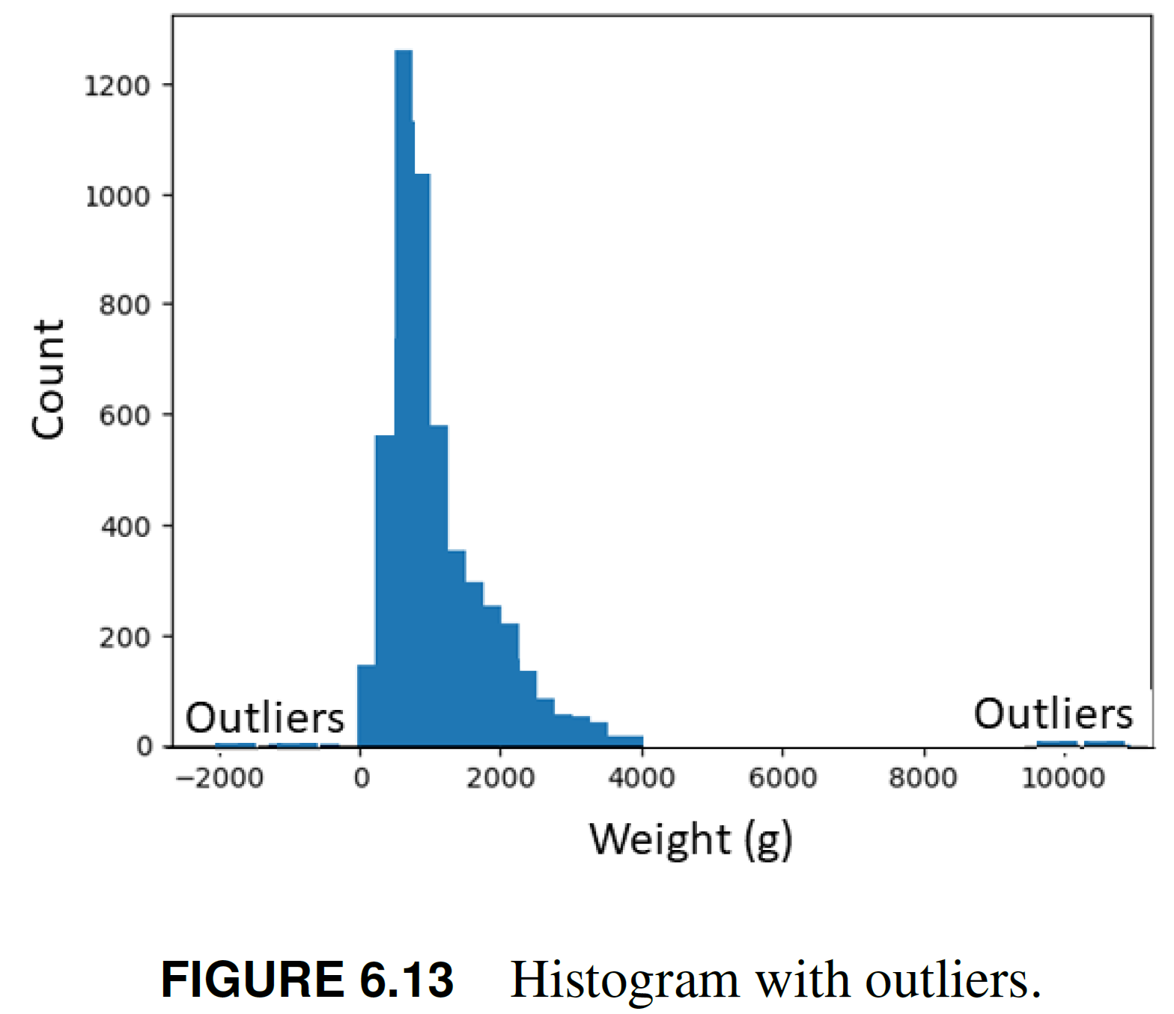
Feature preprocessing
Outlier analysis
Outliers are data points that are significantly different from most of the data, and they can have a big impact on the performance of ML models.
Important to identify and handle outliers appropriately
Techniques
Visualize the data: plotting the data can help identify outliers.
  Box plots, scatter plots, and histograms

Slide 28
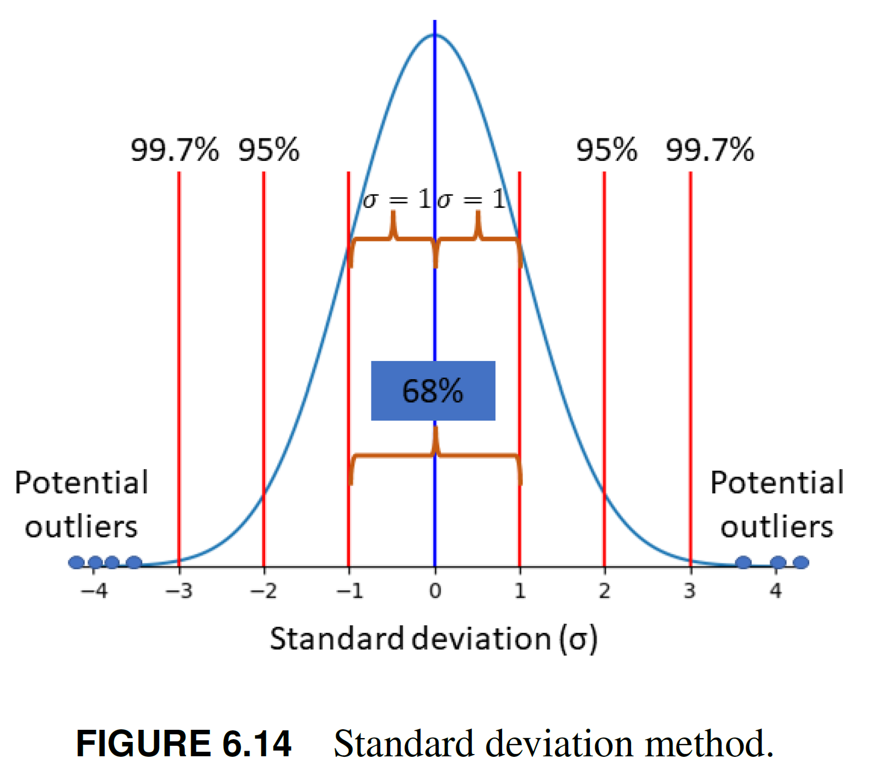
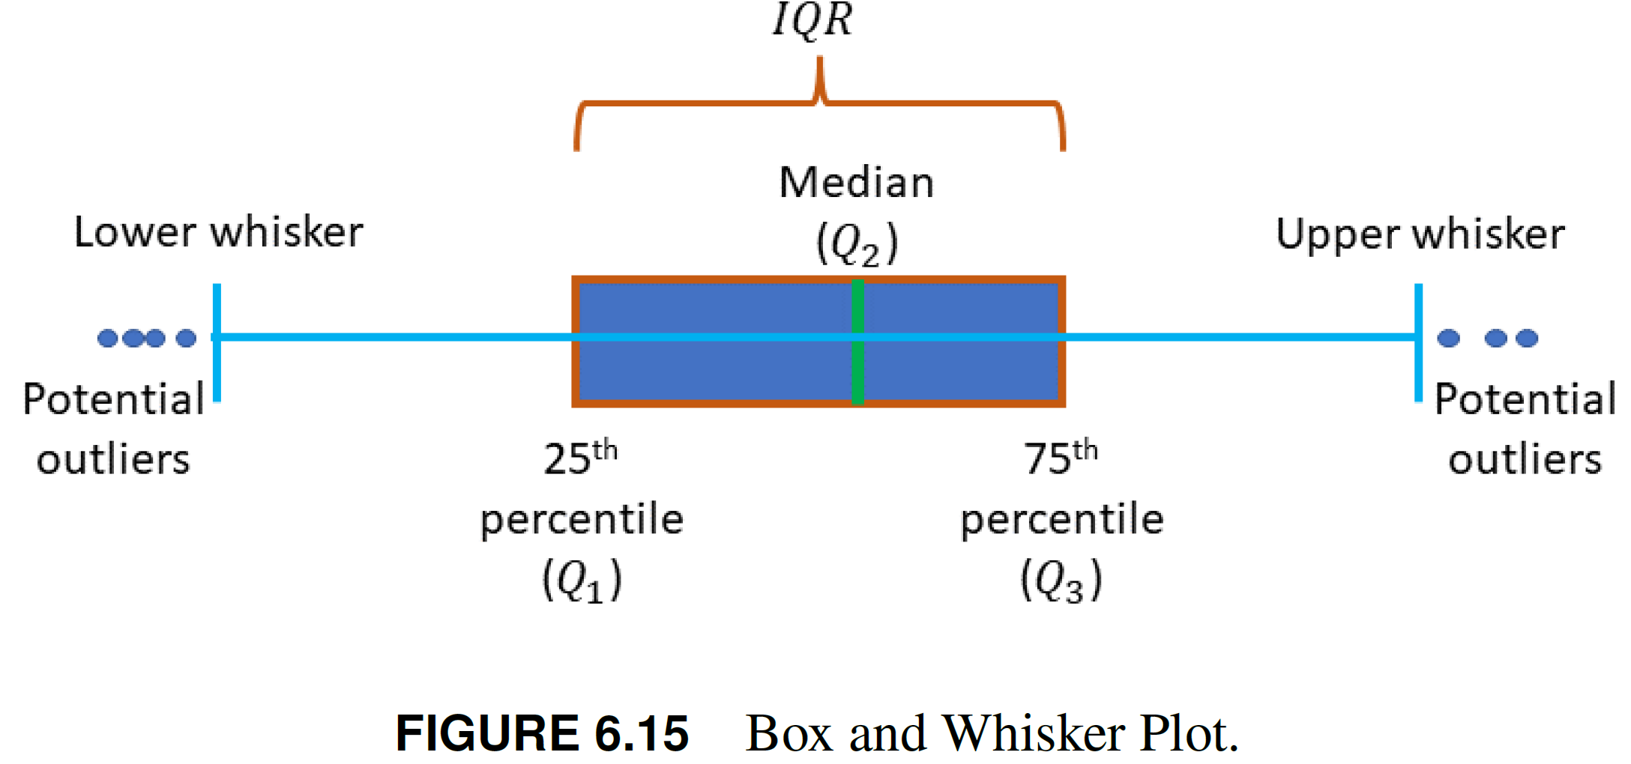
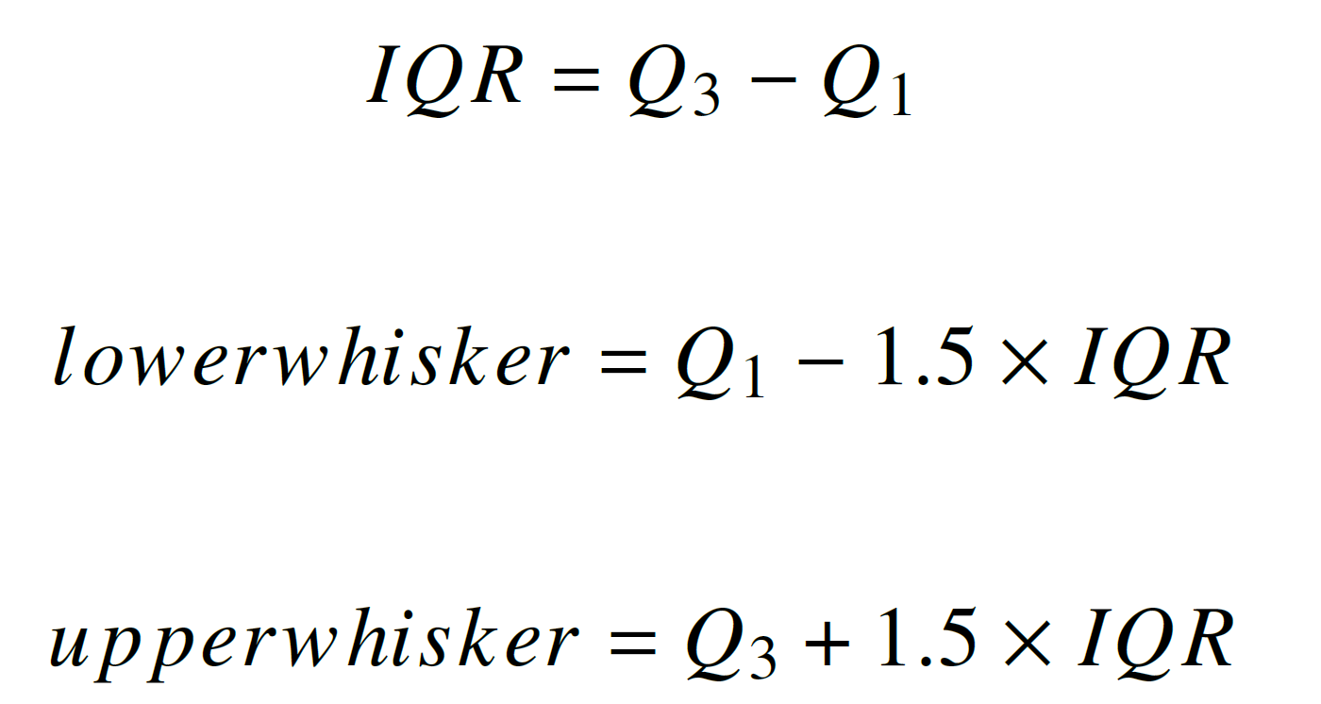
Feature preprocessing
Domain knowledge can also be used to identify outliers
Statistical methods such as standard deviation (𝜎), and interquartile range (IQR)

Slide 29
Feature preprocessing
Remarks
Once outliers have been identified, they can be handled in several ways:
Remove them from the data set
Replace them with a value that is more representative of the data, such as the median or mean
However, it is important to be cautious when handling outliers, as they can provide valuable insights into the data

Slide 30
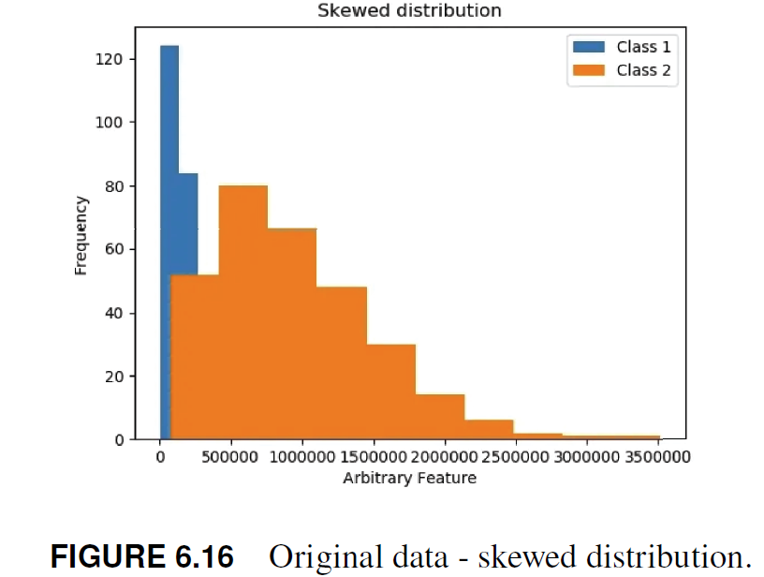
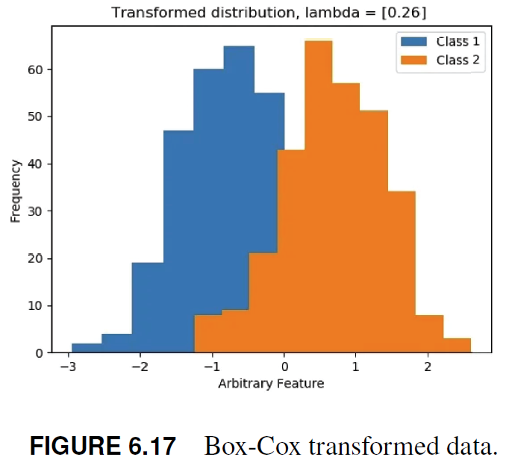
Feature preprocessing
Feature transformation
Process of converting raw data into a set of features that are more suitable for MLA
Taking a mathematical function and applying it to the features, where the goal is to improve the accuracy and performance of the models
Techniques
Transformations for better normal distribution
  Log and Box-Cox transformations convert a skewed distribution to a more normal or less-skewed distribution
The LR algorithm is applied to both data sets, the accuracy
significantly improved after transformation (0.50 vs 0.84)
Mathias Gudiksen. Box-cox transformation, an effective method to improve robustness of your model, 2021.

Slide 31

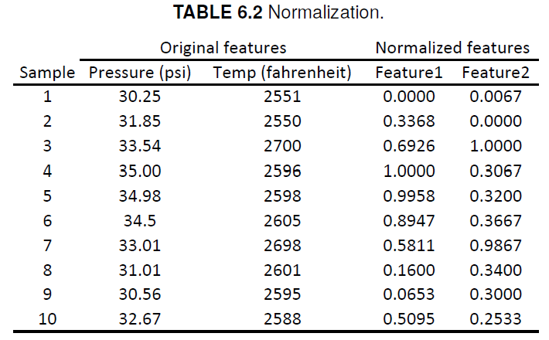

Feature preprocessing
Scaling:
Transform features, so they have a similar scale and range
Applied to learning data sets with features with highly varying engineering magnitudes, values, or units among them
Different engineering scales in the input features can cause problems such as biased model predictions and slow model convergence
  Standardization is the process of transforming data so that it has a mean of 0 and a standard deviation of 1
  Normalization is the process of scaling data to a range of 0 and 1

Slide 32

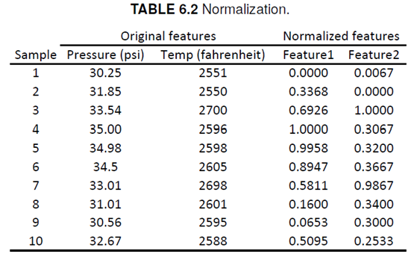
Activity 1
Feature transformation (10 mins)
Normalize features 1 and 2

Slide 33
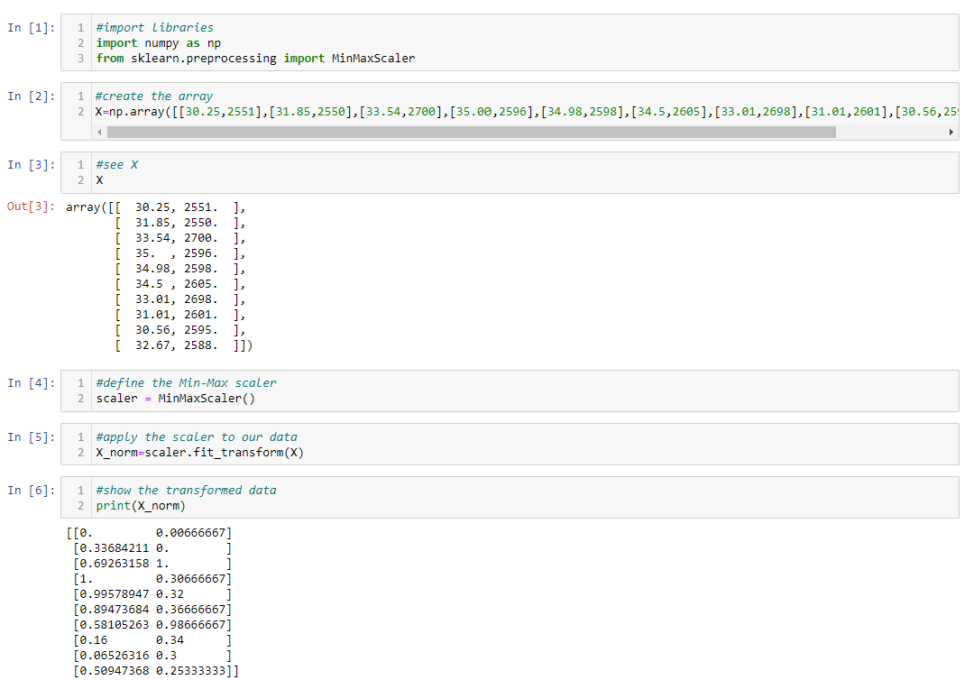
Activity 1
Feature transformation
Python code

Slide 34
Feature preprocessing
In general, it is a good idea to try both (standardization, normalization) techniques and see which one works best.
Feature scaling is mainly required for gradient descent-based MLA such as the LR and ANN, and distanced-based such as the k-nearest neighbors algorithm and support vector machine.
Tree-based such as RF and XGBoost MLAs are fairly insensitive to monotonic transformations

Slide 35
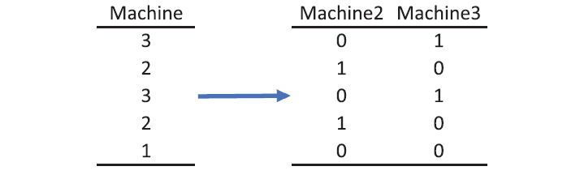
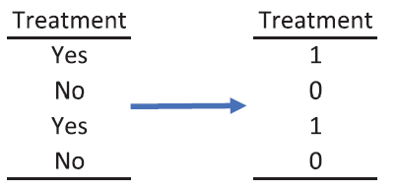
Feature preprocessing
Encoding categorical variables
categorical variables are variables that take on a limited number of discrete values, such as “machine1”, “machine2”, or “machine3”
These variables need to be transformed into numerical variables so that they can be used in ML models
One-hot encoding or binary encoding

Slide 36
Feature preprocessing
Remarks
Whereas some MLA are sensitive to some pre-processing steps, others are virtually invariant.
Choice of feature transformation techniques depends on the specific problem and data being analyzed
Trial and error process to determine which techniques work best for a particular data set and machine learning model

Slide 37
Feature preprocessing
Chapter remarks
Success in solving the pattern classification problem highly relies on the effective application of domain knowledge to generate the raw data
Feature engineering techniques to create features, select the most important ones, and preprocess them to create the learning data set
Iterative approach that requires feedback loops focused at improving the solution process
Accessing the data and blindly applying a MLA is not a good practice
Before the learning process, it is important to visualize the features, study their importance and redundancy, and address the technical challenges, such as missing records, outliers, diverse scales, etc.
Important to understand how the MLA works before preprocessing the data.
This understanding would help the Quality 4.0 engineers to create the right data set for the chosen MLA

Slide 38
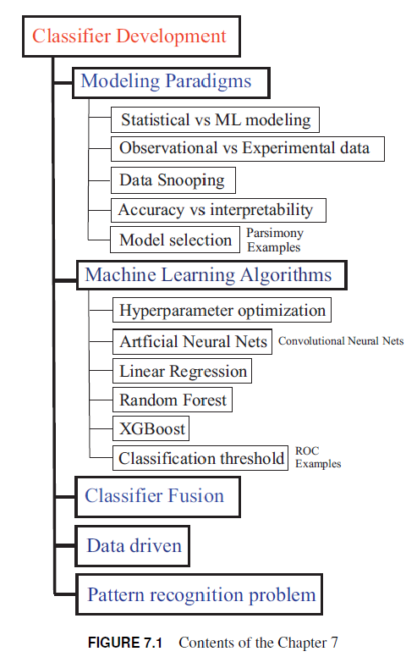
Chapter 7: Classifier Development
Notes:
In the following slides

Slide 39
Classifier development
Before applying the MLAs to the learning data set, it is important to:
  Understand the ML modeling paradigms
  How to efficiently train them
  Define the classification threshold (CT)
Since there are hundreds of MLA, testing all of them may not be a feasible or efficient task. Probably not even required
Random forest (RF), and XGBoost are studied in this training
They have shown superior performance solving real complex problems in the Kaggle competitions
Each MLA are described from high level perspective:
  How they work
  Their hyperparameters
  Training strategies

Slide 40
Classifier development
Classifier is the most important component of the learning quality control (LQC) system
This phase defines the success of the project
Measures of classification performance and/or the committed 𝛼 and 𝛽 errors of the classifier in the test set, are compared with the project requirements to determine if the quality problem has been successfully solved or addressed

Slide 41
Modeling paradigms
Notes:
In the following slides

Slide 42
Modeling paradigms
Statistical versus machine learning modeling
ML modeling and statistical modeling are two approaches to building models that can make predictions or inferences based on data
Statistical modeling is more focused on understanding the data and making inferences
ML modeling is more focused on accurately predicting outcomes based on the data
Providing causal explanations is a challenging task, as the most powerful MLA such as ANN and XGBoost are considered black boxes
Classification trees or linear regression models are highly explainable, enabling causation efforts

Slide 43
Modeling paradigms
Observational versus experimental data
Observational data and experimental data are two types of data that are often used in scientific research and ML modeling
Observational data is collected by observing and measuring the process, without any direct intervention or manipulation by the observer
Process engineering notions are used to observe the process using connected devices, such as smart sensors

Slide 44
Modeling paradigms
Experimental data is collected through direct manipulation of the system or phenomenon being studied
Typically involves the use of controlled experiments, where one or more variables are manipulated, and the outcomes are observed and measured
In ML modeling, both observational data and experimental data can be used to train predictive models
When working with observational data, each feature must be evaluated from an engineering or physics perspective before the training process to ensure no spurious patterns are learned

Slide 45
Modeling paradigms
Data snooping
Data snooping, also called data fishing or data dredging, is the inappropriate use of data mining techniques to find statistically significant patterns in data or to uncover misleading relationships
Data snooping refers to statistical inference that the researcher decides to perform after looking at the data
In statistical modeling, data snooping can occur when researchers test multiple hypotheses on the same data set and select the hypothesis that provides the best fit to the data, without correcting for the multiple comparisons
This can lead to spurious findings and inflated Type I error rates

Slide 46
Modeling paradigms
Data snooping
Data snooping, also called data fishing or data dredging, is the inappropriate use of data mining techniques to find statistically significant patterns in data or to uncover misleading relationships
Data snooping refers to statistical inference that the researcher decides to perform after looking at the data
In statistical modeling, data snooping can occur when researchers test multiple hypotheses on the same data set and select the hypothesis that provides the best fit to the data, without correcting for the multiple comparisons
This can lead to spurious findings and inflated Type I error rates

Slide 47
Modeling paradigms
In ML, data snooping can occur when researchers use the same data to both train and test a model, without using a separate validation or test set
May lead to over-fitting, where the model fits the training data too closely and does not generalize well to new data
To avoid data snooping, it is important to use a separate validation or test set to evaluate the performance of a model
This can help to provide an unbiased estimate of the performance of the model on new data

Slide 48
Modeling paradigms
Accuracy vs Interpretability
One of the most important trade-offs quality engineers must be aware of, is posed by the prediction ability (accuracy) of a model versus its causal explanation or Interpretability
Trade-off should be considered from the beginning of the project, as it guides the solution process
Accuracy refers to the ability of a MLA to predict outcomes based on input data.
This is typically the primary focus of the LQC systems
If the classifier cannot predict, it cannot be used for any further activity, such as root cause analysis.

Slide 49
Modeling paradigms
Causal explanation is the ability of an MLA to explain why a particular prediction was made
Interpretability enables to understand the underlying causes generating the defective manufacturing items

Slide 50
Modeling paradigms
Model selection
Model selection methods help to solve the bias-variance trade-off by selecting the right complexity
Founded on the principle of parsimony
Usually reward for prediction ability and penalize for model complexity
Complexity refers to the number of features or parameters in the model
Parsimonious modeling in ML refers to the process of building a model with a minimal number of features or parameters while still achieving good predictive performance

Slide 51
Modeling paradigms
Benefits
Simplicity
Computational efficiency
Reduced risk of overfitting
Improved interpretability
Cost-effective

Slide 52
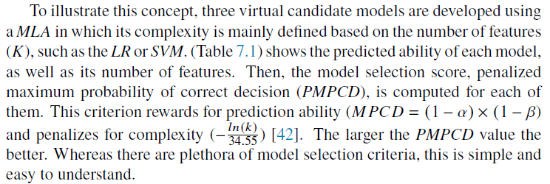
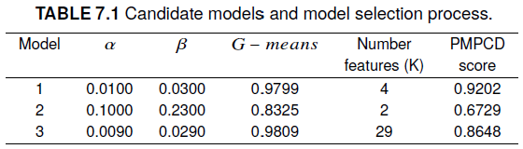

Activity 2
Model selection (10mins)

Slide 53
Activity 2
Model selection
Candidate models one and three have virtually the same predictive ability G-means= 0.9799 vs G-means= 0.9809
However, the latter is an over-complex model (𝑘 = 4 vs 𝑘 = 29), as it seems that the pattern is captured by only four features, and the extra 25 trivial features of the candidate model three add only complexity
Candidate model one is selected with a PMPCD = 0.9202

Slide 54
Machine learning algorithms
Notes:
In the following slides

Slide 55

Machine learning algorithms
MLAs are used to compute the predicted probabilities of a manufactured item to belong the defective class
Random forest (RF), and XGBoost are studied in this training
Although the RF, XGBoost, and ANN MLA have the capacity to learn complicated non-linear patterns in hyper-dimensional spaces, it is always a good idea to try several of them to find the best
Training several MLA allow to explore different classifier fusion schemes to optimize prediction ability of the top performer
Note: ANNs and meta-learning algorithms (fusion rules) are covered in the master black belt training

Slide 56
Machine learning algorithms
Hyperparameter Optimization
Hyperparameter optimization is the process of selecting the optimal set of hyperparameters for a ML model
Hyperparameters are values that are set prior to training the model, and they can have a significant impact on the model’s performance
Common hyperparameters include:
  Learning rate
  Regularization strength
  Number of hidden layers
  Number of neurons per layer
  Number of trees
  Number of epochs
  Test size
  Number of iterations
  Kernels (polynomial, linear, Gaussian, RBF)
  C value on the SVM

Slide 57
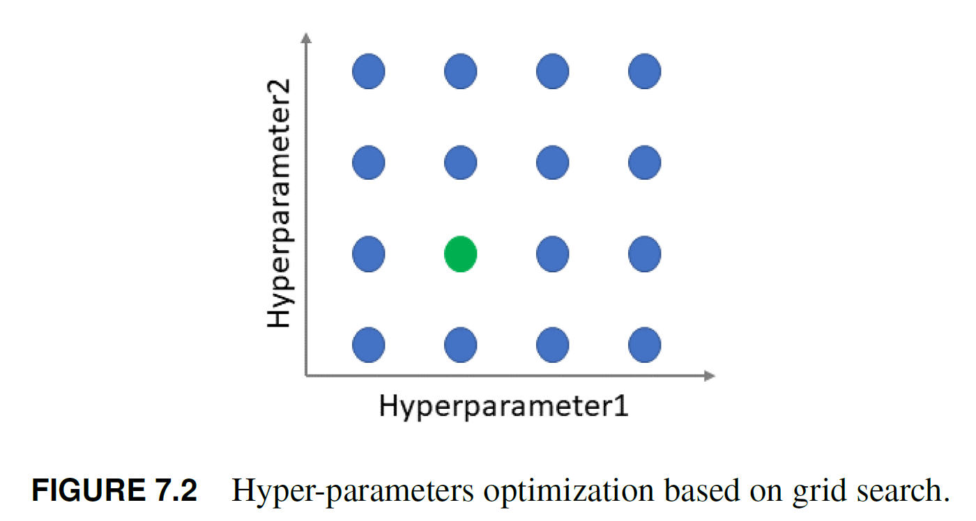
Machine learning algorithms
Two popular methods for hyperparameter optimization are:
Grid search, it involves defining a grid of hyperparameter values to search over
Exhaustively evaluates each combination of hyperparameters and selects the combination that performs the best on a validation set

Slide 58
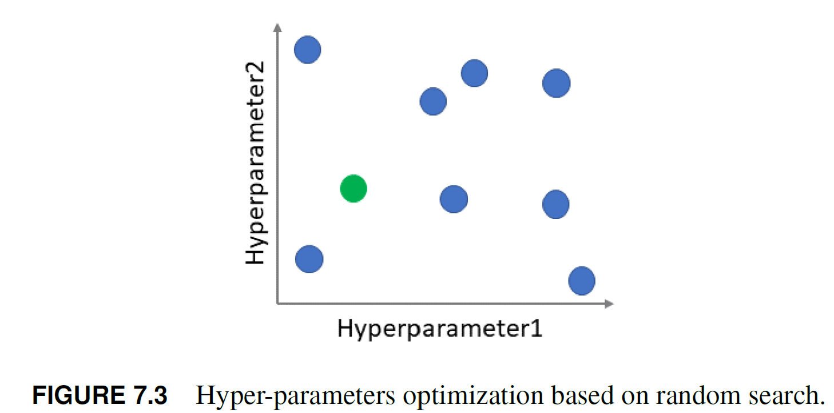
Machine learning algorithms
Random search, on the other hand, randomly samples hyperparameters from a predefined range or distribution
More efficient than grid search when there are many hyperparameters to search over, because it does not require evaluating all possible combinations
Randomly selects a subset of hyperparameters to try, and the number of samples can be controlled by a user-defined budget

Slide 59
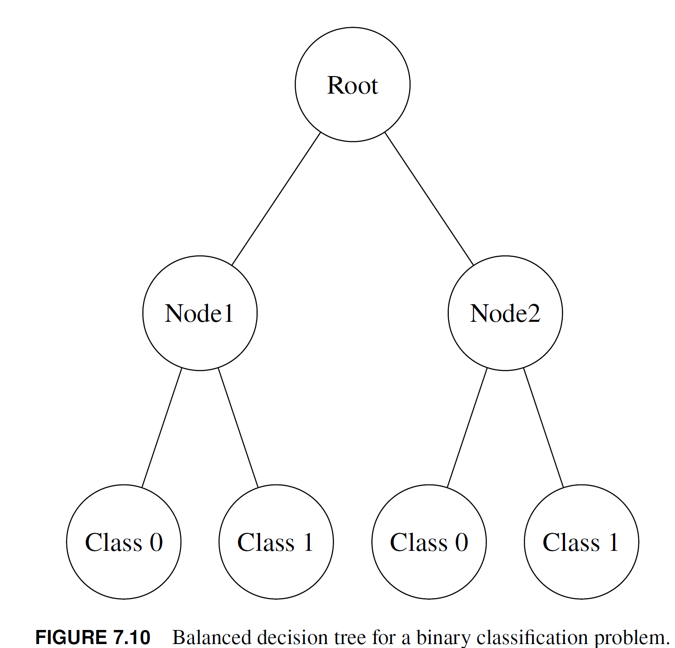
Machine learning algorithms
Root node
Tree models starts at a root node, and from that point its goal is to find a split (decision) that separates the data into two distinct groups
Algorithm then evaluates each feature and determines the best current split, trying to maximize the evaluation metric to create children nodes
Selected metric measures how well the classes are separated
Process is applied recursively, creating a hierarchical structure of nodes and decision rules, until a stopping criteria is met
Common stopping criteria include a given metric threshold and the maximum depth of the tree
When the stopping criteria is met, the node becomes a leaf node that represents the majority class of the samples
Maximum depth
Decision node
Branch
Leaf node

Slide 60
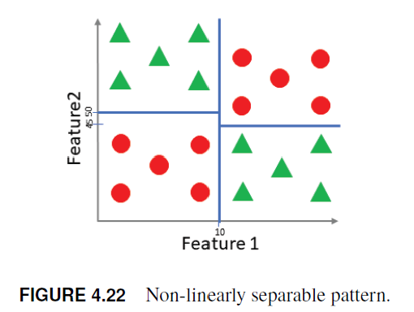
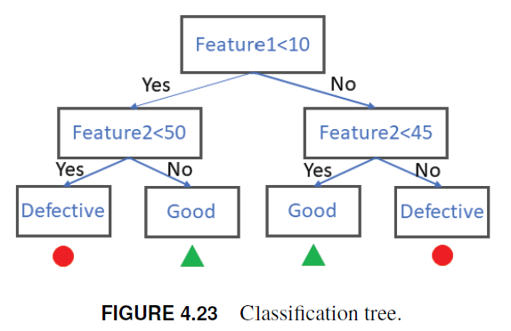
Machine learning algorithms
Tree model
From the green belt training
Classification rules

Slide 61
Machine learning algorithms
Limitations of tree models
Decision trees are prone to overfitting, especially if they are allowed to grow in depth
Predictions may change drastically even with small input changes in the training data

Slide 62
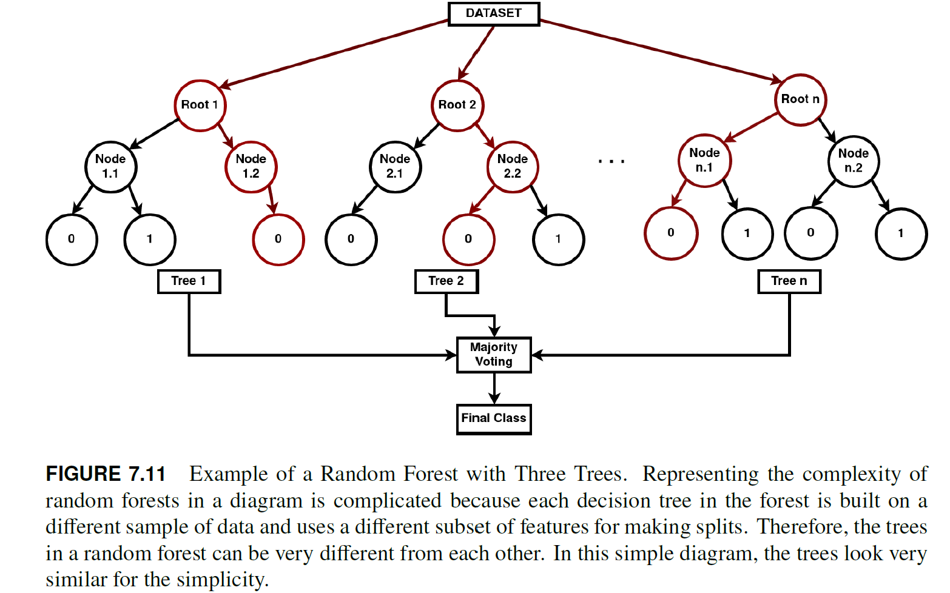
Machine learning algorithms
Random forest (RF)
Combine the predictions of multiple "weak“ learners (the individual trees, which might not have great predictive power on their own) to form a "strong" learner (the forest, which often has better predictive power)
For example by combining the prediction of multiple trees, each trained on a different subset of the data (randomness), they mitigate overfitting, hence reducing the model variance whilst increasing the model bias

Slide 63
Machine learning algorithms
Key concepts in random forests
Bootstrapping: For each tree, a random subset of the training data is selected with replacement (i.e., allowing duplicate samples). This subset is used to build a single decision tree
Feature bagging: At each split in the decision tree, only a random subset of the features is considered for splitting. This helps decorrelate the trees, which reduces overfitting and improves generalization
Predictions from all trees are combined by taking the majority vote

Slide 64
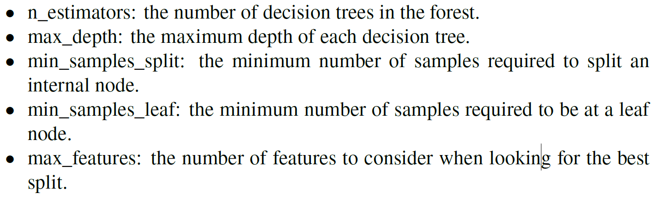
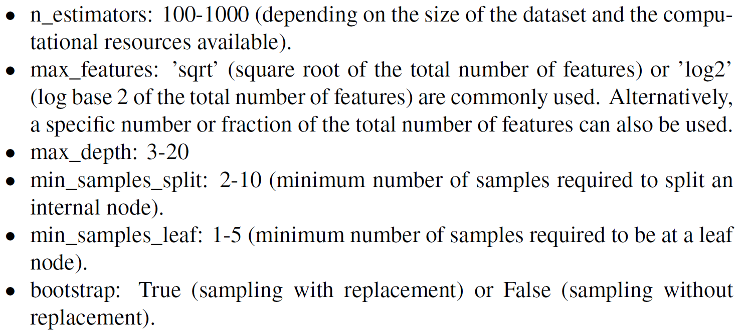
Machine learning algorithms
Hyperparameters
Recommended values
Note: default values are good for promptly defining a prediction benchmark
Sources for learning the mathematics
Vrushali Y Kulkarni and Pradeep K Sinha. Pruning of random forest classifiers: A survey and future directions. In 2012 International Conference on Data Science & Engineering (ICDSE), pages 64–68. IEEE, 2012.
Philipp Probst and Anne-Laure Boulesteix. To tune or not to tune the number of trees in random forest. The Journal of Machine Learning Research, 18(1):6673–6690, 2017.

Slide 65
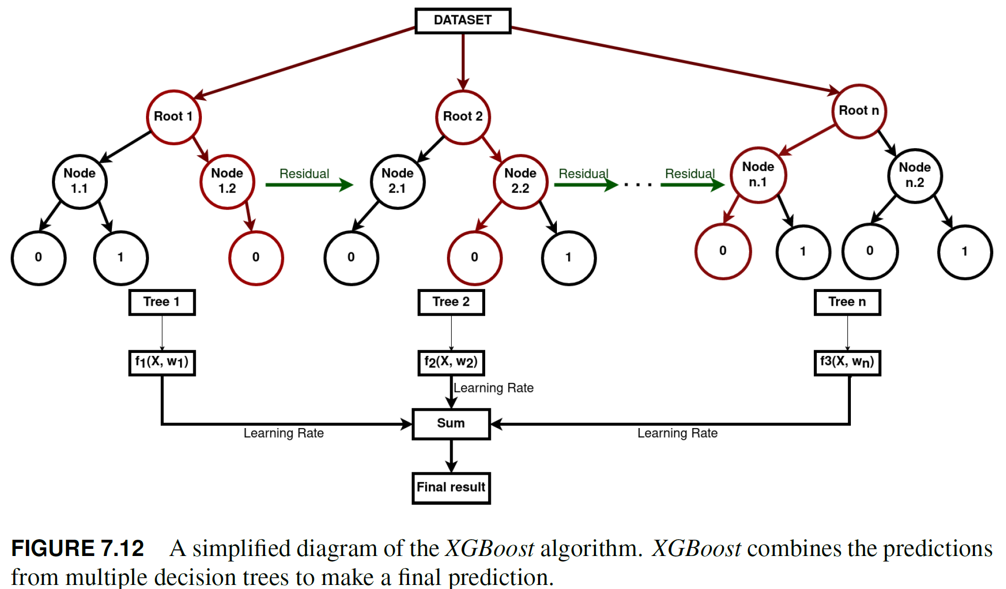
Machine learning algorithms
XGBoost
eXtreme Gradient Boosting (XGBoost) is a MLA that belongs to the family of gradient boosting methods that well suited for structured data
Gradient Boosting is a ML technique that produces a prediction model in the form of an ensemble of weak prediction models
Main idea behind Gradient Boosting is to add new models to the ensemble sequentially
At each iteration, a new weak, shallow decision tree is trained with respect to the error of the whole ensemble learnt so far
  Each subsequent tree attempts to correct the mistakes of the previous ones

Slide 66
Machine learning algorithms
Each subsequent model is specifically trained to predict the residuals, or errors, of the existing ensemble’s predictions
Residuals are calculated simply as the difference between the current prediction and the true values
To find the residuals, Gradient Boosting uses gradient descent. Computing the derivative (gradient) of the loss function (the measure of error) with respect to the prediction
Loss function quantifies the difference between the predicted and actual outcomes, and gradient descent is used to minimize this loss function
Each new model’s predictions are scaled by a factor, the learning rate (also called shrinkage or step size), before they are added to the ensemble’s prediction
  This helps to control the rate at which the algorithm learns from the new models and prevents overfitting
Predictions of all the generated models are then added together to make the final prediction

Slide 67
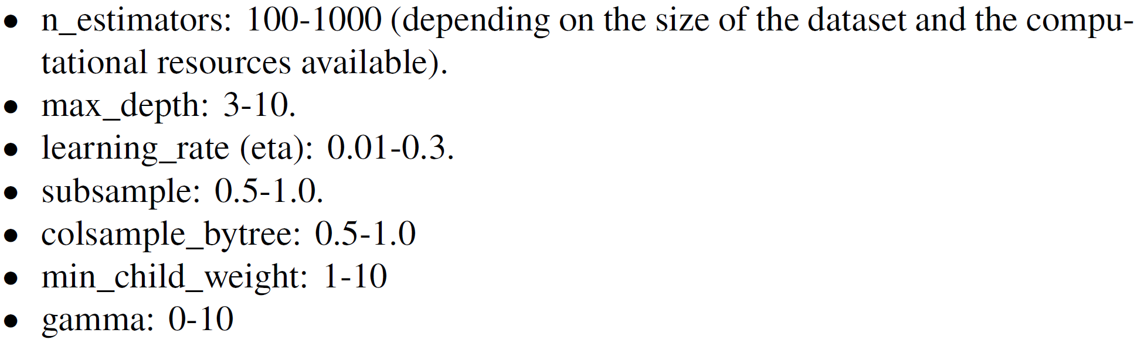
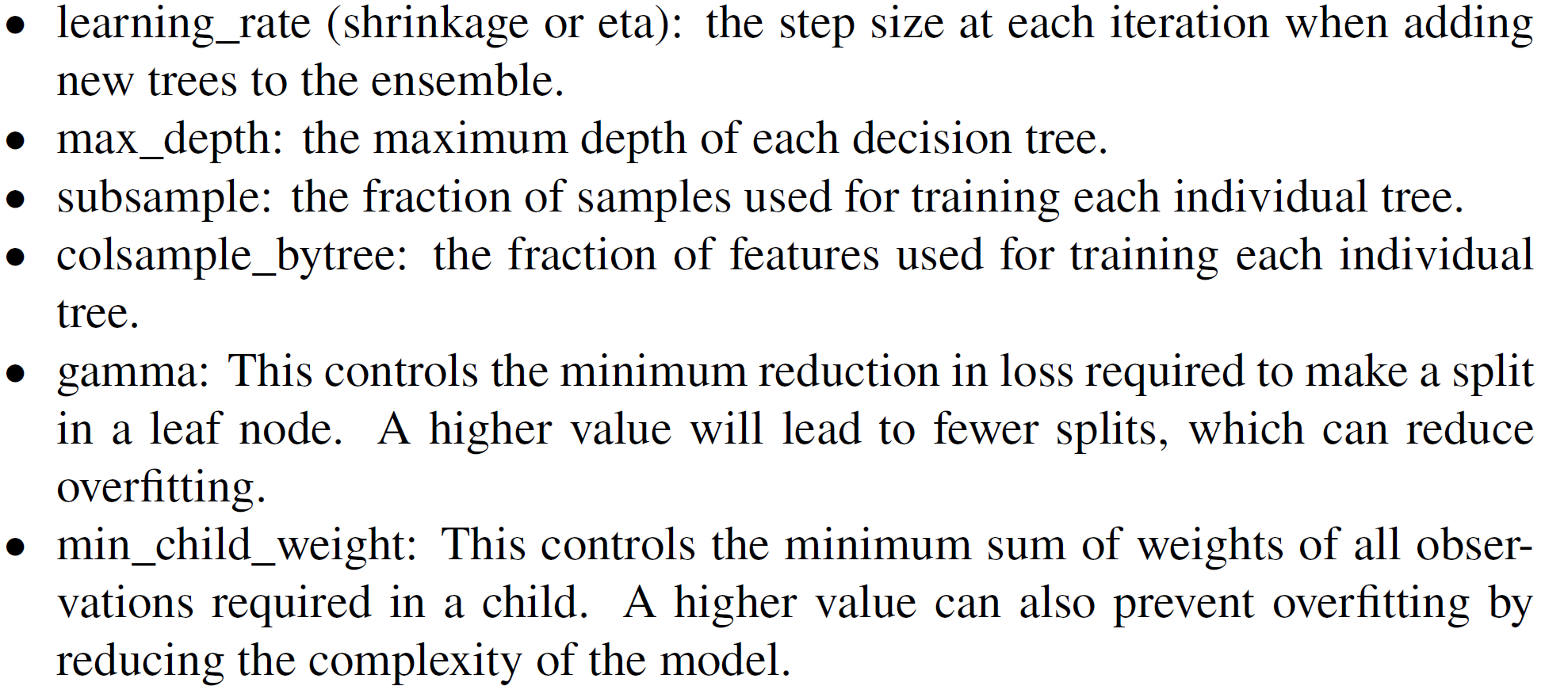
Machine learning algorithms
Hyperparameters
Recommended values
Note: default values are good for promptly defining a prediction benchmark
Sources for learning the mathematics

Slide 68
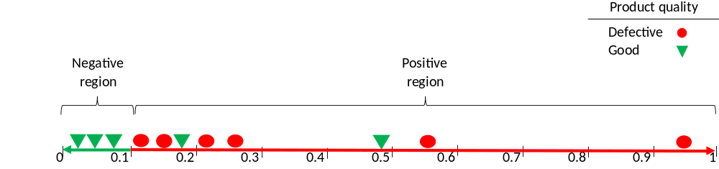
Machine learning algorithms
Classification threshold (CT) definition
Once a model have been trained, the next step is to find its associated CT
CT of 0.50 is rarely the best option in problems with highly or ultra imbalanced data sets
Optimal CT needs to be searched and optimized
Small predicted probabilities can carry a lot of meaningful information in highly unbalanced data sets

Slide 69


Machine learning algorithms
From the green belt training
Specialized metrics such as the 𝐺−𝑚𝑒𝑎𝑛𝑠 or 𝑓1 scores are suitable to quantify the predicted probabilities
These metrics effectively solve the trade-off posed by the FNs and FPs from a business perspective, e.g., boost detection

Slide 70

Machine learning algorithms
Receiver operating characteristic (ROC) curve
Graphical representation of the performance of a model as the CT is varied.
Created by plotting the true positive rate (TPR) in the y-axis against the false positive rate (FPR) in the x-axis, at various candidate classification threshold (CCTs) values

Slide 71
Machine learning algorithms
ROC curve steps
1. Model is applied to the test dataset to obtain the predicted probabilities of each sample
2. CCT values are defined:
Evenly spaced between 0 and 1
Specific percentiles of the predicted probability distribution
Mid points of the sorted predicted probabilities
3. At each CCT value, the number of TP, FP, TN, and FN are counted. Then, the true positive rate (TPR) and false positive rate (FPR) are calculated, this represents the model’s performance at different thresholds.
4. Complete separation of classes is described by the point (0, 1) of the ROC curve, indicating 0% FP and 100% TP.

Slide 72


Machine learning algorithms
Finding the optimal threshold
Mid points of the sorted predicted probabilities

Slide 73



Machine learning algorithms

Slide 74
Machine learning algorithms
Coding exercise

